Slide 1
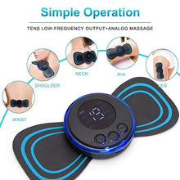

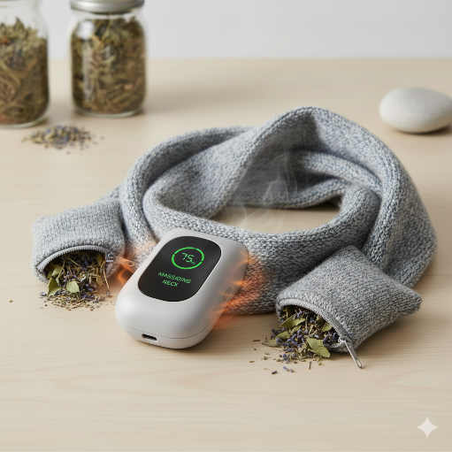
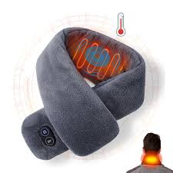
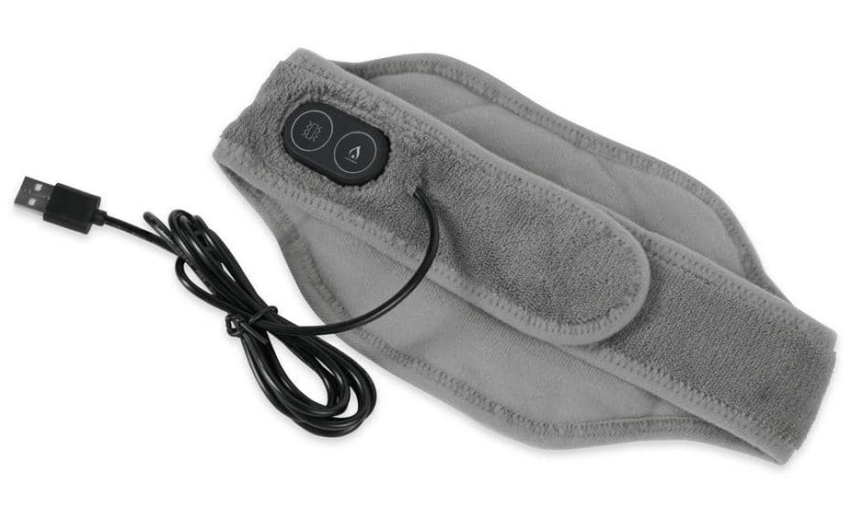
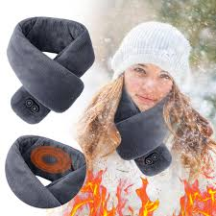
PROJECT TITLE: SCARF WITH MASSAGER
S.No | Name of the student | Year/Dept | Email Id
1 | SHANMUGA PRIYAA K | II/ECE | shanmugapriyaa.ec24@krct.ac.in
2 | SHIVANANDHINI S | II/ECE | shivanandhini.ec24@krct.ac.in
3 | SOWMIYA M | II/ECE | sowmiya.ec24@krct.ac.in
4 | SUJITHA M | II/ECE | sujitha.ec24@krct.ac.in

Slide 2


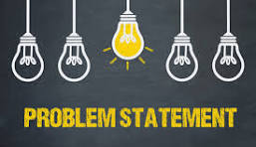
PROBLEM STATEMENT
Many people experience daily neck and shoulder tension due to long working hours, stress, poor posture, and screen time. Traditional scarves only provide warmth, and massagers are often bulky, inconvenient, or not portable. There is a need for a product that combines everyday comfort with therapeutic relief in a simple, wearable form.

Slide 3
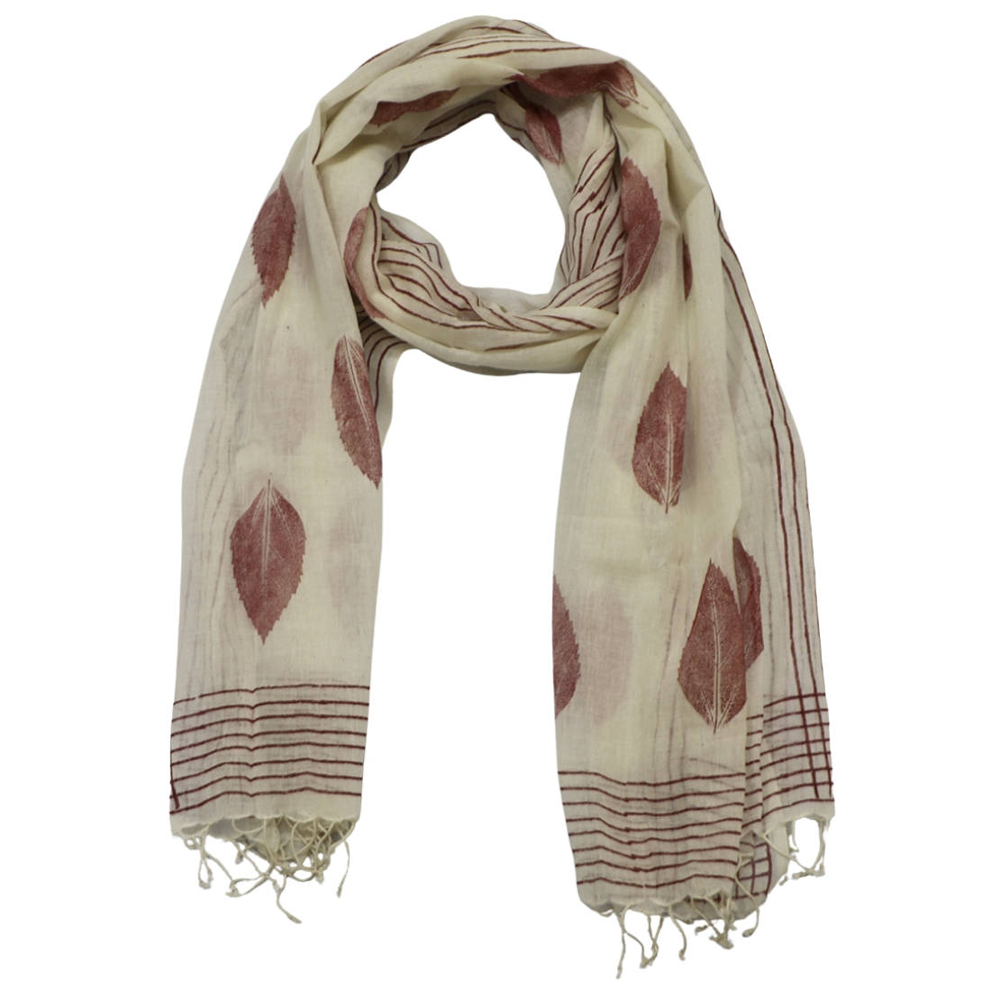
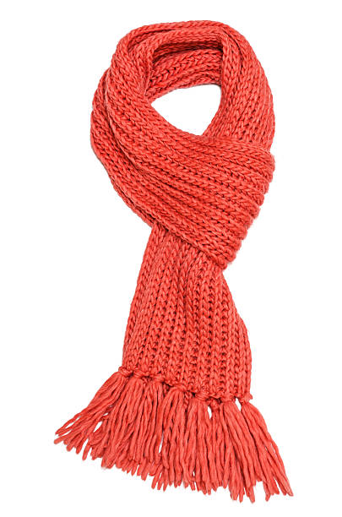
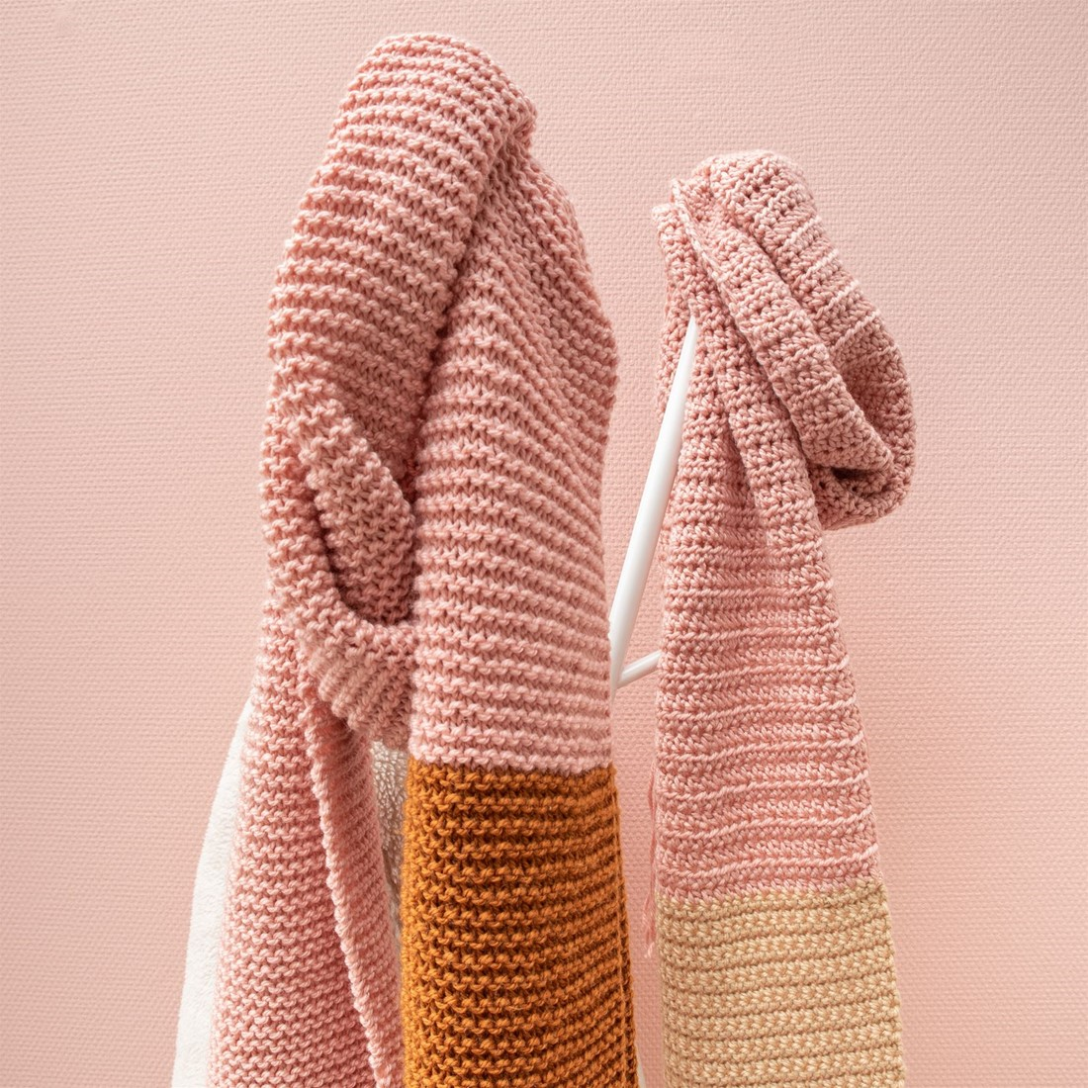
EXISTING PRODUCT DETAIL
A simple scarf is typically a rectangular piece of fabric worn around the neck, shoulders, or head for warmth, comfort, and style. It’s usually lightweight and versatile, suitable for everyday fashion or casual outings.
Material : Cotton, rayon, polyester, viscose, or soft blends — chosen for comfort and breathability.
Shape : Usually rectangular or long strip for wrapping around the neck.
Use : Everyday wear, layering, light warmth, casual style.
Care : Often hand wash or gentle machine wash depending on fabric.
Size : Commonly ~70–190 cm in length and ~50–80 cm in width.

Slide 4
SOLUTION (OR) PROPOSED DESIGN
To address daily neck tension, stress, and the need for portable relaxation, the proposed solution is a Herbal Therapy Massaging Scarf — a wearable scarf that combines:
Herbal heat therapy using natural pouches
Targeted neck massage
Soft, stylish scarf design for everyday use
Design Features & Functionality
Comfort-Based Design
Lightweight and flexible
Fits comfortably around the neck without bulk
Designed for long usage in home, office, or travel environments

Slide 5
VALUE PROPORTION
Instant neck relief, natural herbal comfort, and stylish warmth all in one wearable product.
The Herbal Therapy Massaging Scarf provides a unique combination of heat therapy, herbal aromatherapy, and vibration massage in a lightweight, fashionable scarf. It is designed for people who want portable relaxation, stress relief, and comfort.
3-in-1 Wellness Solution
Combines warmth + herbal aroma + massage,
replacing multiple products like heating pads, diffusers,
and neck massagers
Natural Healing
Herbal pouches provide calming aromatherapy
using lavender, chamomile, peppermint, etc.,
offering relaxation without chemicals or medication.
Easy to Use
Simple one-button control for heat and massage settings, making it user-friendly for all age groups.
Stylish & Comfortable
Looks like a regular scarf — soft, elegant, and wearable.
People can use it daily without looking like they’re wearing a device.

Slide 6
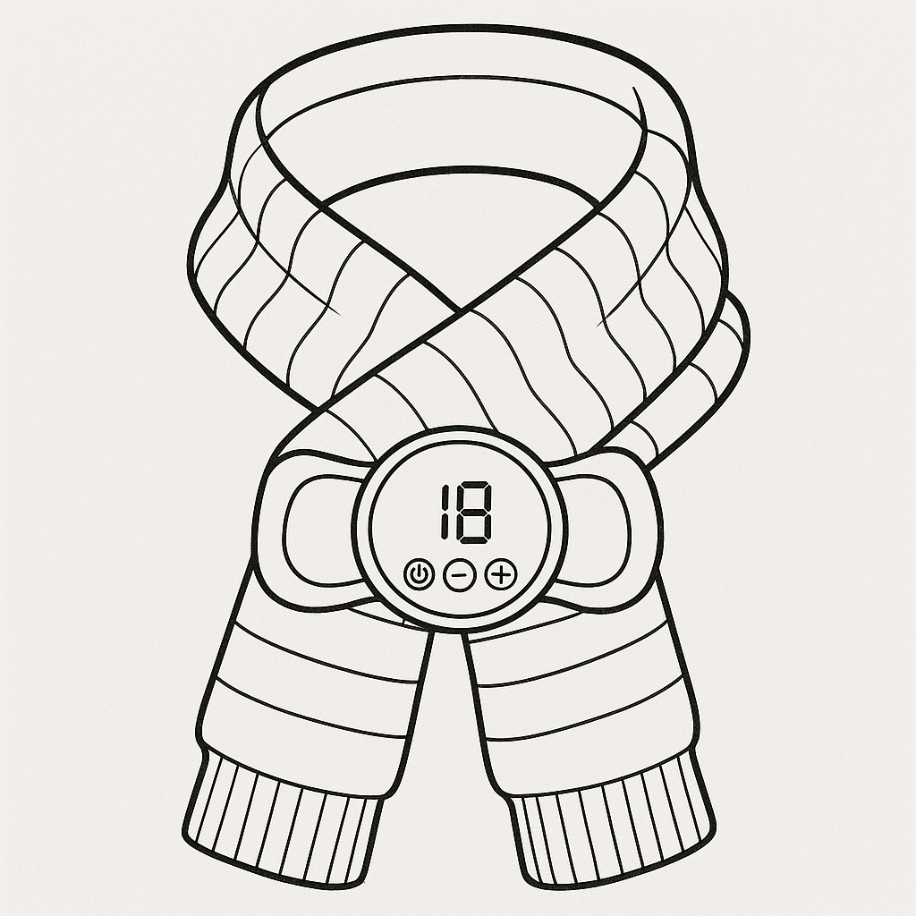
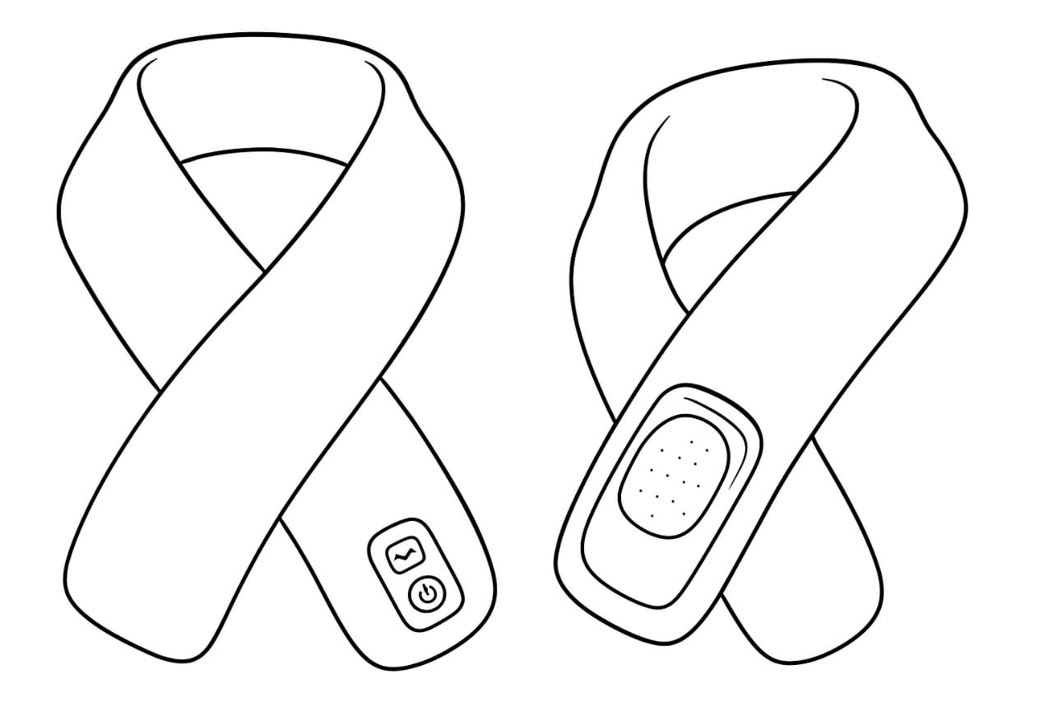
DESIGN

Slide 7
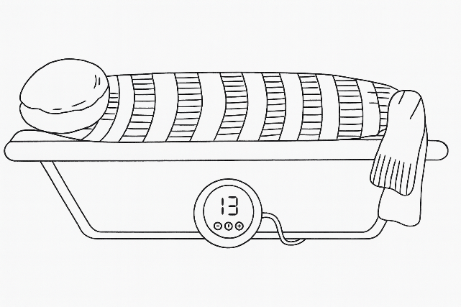
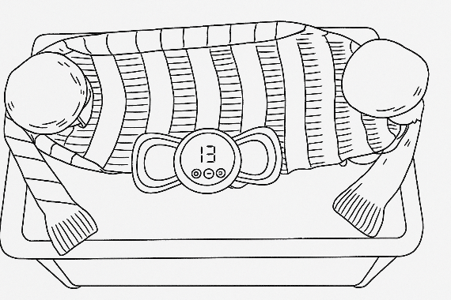
DESIGN
The design of the Scarf with Massager focuses on merging economic comfort with therapeutic components in a compact and stylish structure. The outer body of the scarf is made using soft, lightweight, skin-friendly fabric such as fleece or wool to maintain warmth and comfort during usage. The internal layout is carefully planned to include motor pockets along the neck region, ensuring that the vibrating motion directly targets areas most affected by tension, such as the cervical muscles and upper shoulders.

Slide 8
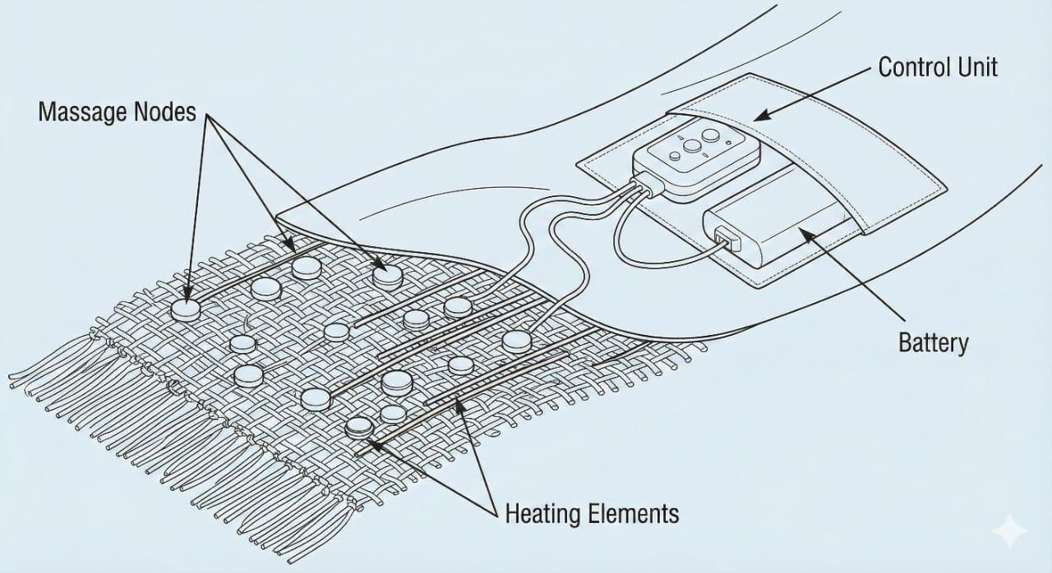
DESIGN
Heat therapy and vibration therapy are the two major mechanisms widely used in pain-relief devices. Heat therapy improves blood circulation and loosens tight muscles, reducing stiffness and discomfort. This mechanism is commonly used in electric heating pads, hot water bags, and rechargeable heat packs. However, these devices are often not wearable, and most of them need to be plugged into a power source during use, making them suitable only for indoor settings.

Slide 9
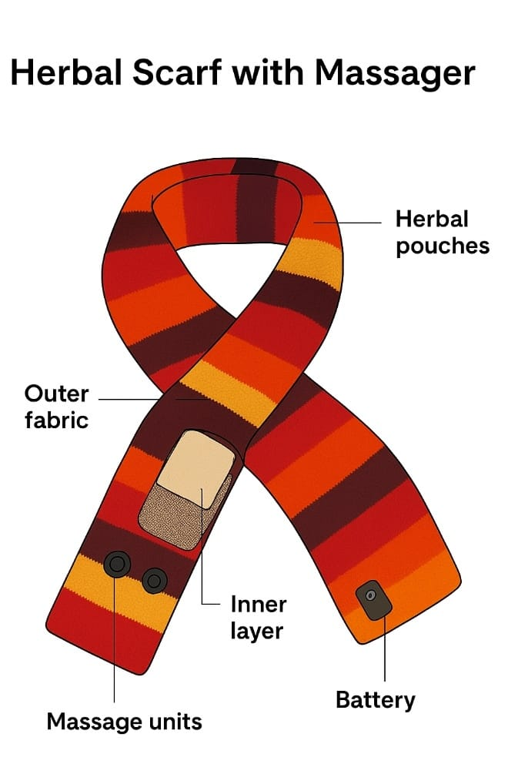
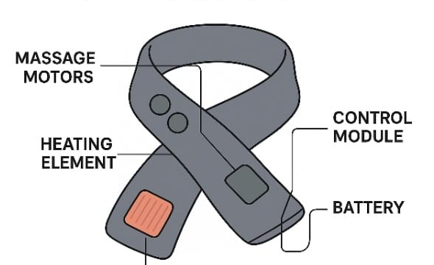
WORKING OF INVENTION
The Scarf with Massager operates using a compact electro-therapeutic system integrated into a soft wearable fabric. When powered on, the rechargeable battery supplies regulated energy to the vibration motors and heating unit. Users can select Massage Only or Massage + Heat modes through the control button. The vibration motors at the neck and shoulder areas provide gentle cyclic vibrations to relax muscles and improve blood circulation. This design helps relieve muscle stiffness caused by prolonged work, mobile usage, driving, and cold exposure while ensuring comfort during extended use.

Slide 10
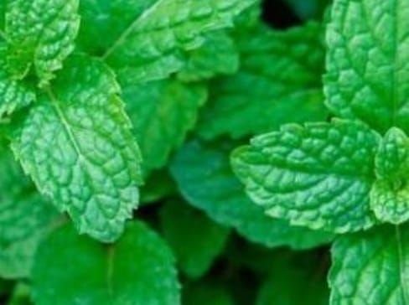
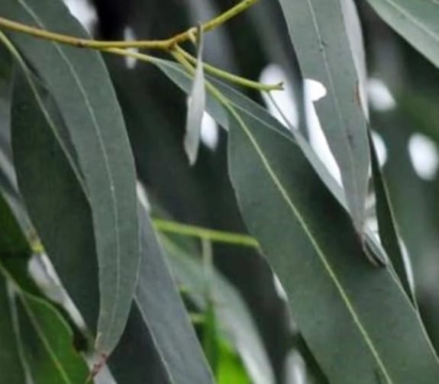
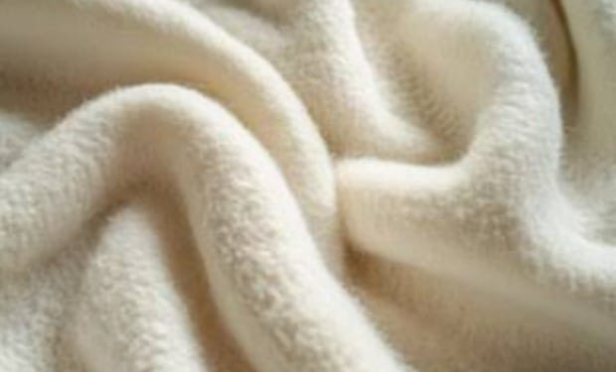
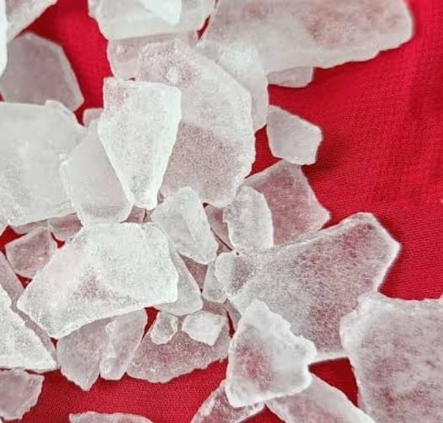
MATERIALS
Outer Fabric: Soft wool blend or microfiber.
Inner Lining: Cotton insulation layer.
Herbal fillings:Eucalyptus,camphor,mint
Power: 3.7 V rechargeable battery.

Slide 11
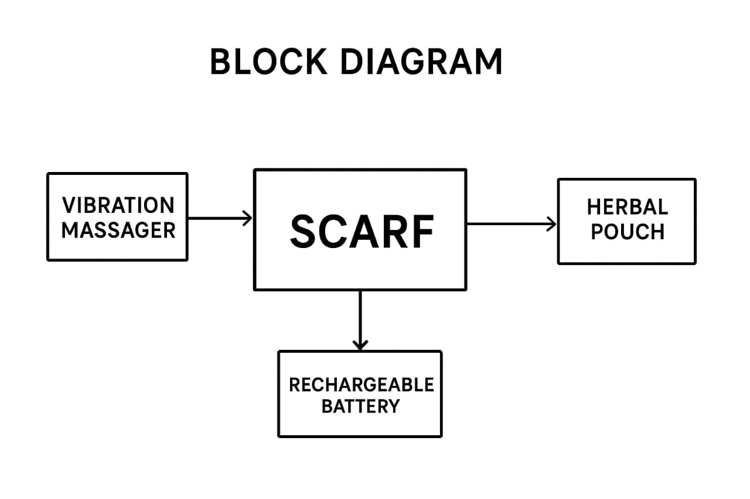
FLOWCHART

Slide 12


REVENUE MODEL
Direct Sales: Online and retail sales of scarves.
Premium Versions: Added heating or Bluetooth control.
Accessories: Extra batteries, fabric covers, and charging pouches.
Bulk Sales: Corporate wellness gifts and travel accessories.

Slide 13
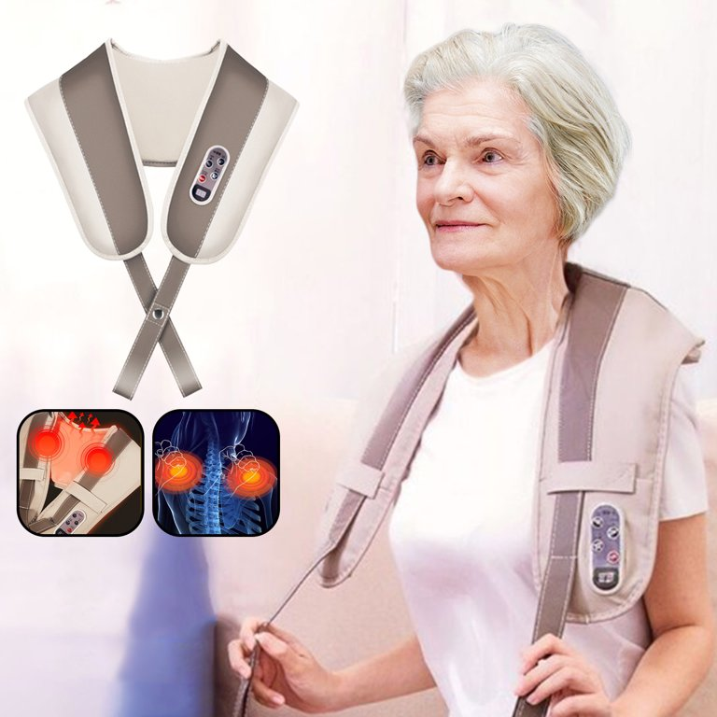
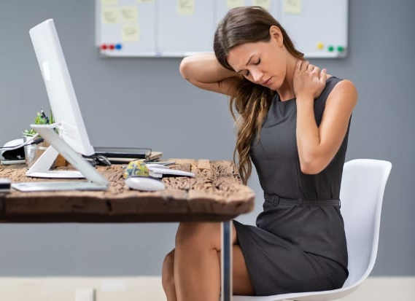
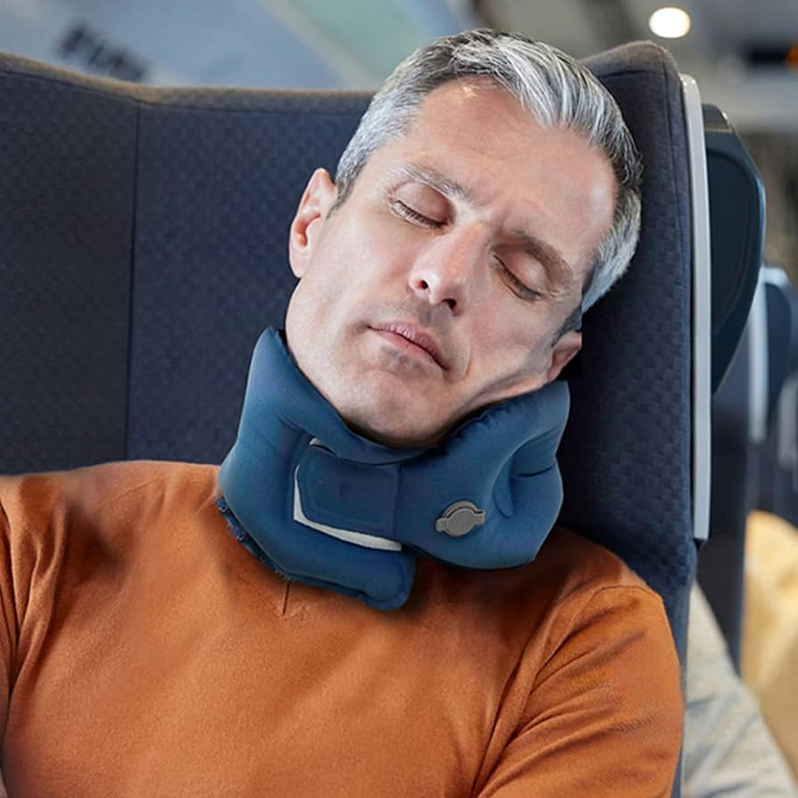
TARGET MARKETING
PRIMARY AUDIENCE
SECONDARY AUDIENCE

Slide 14



MARKETING STRATEGY
The marketing strategy for the Scarf with Massager focuses on creating a strong brand presence by highlighting the product’s unique benefits and real-life applications. To begin with, online promotion plays a central role, as digital platforms allow targeted advertisements to reach specific groups such as students, working professionals, elderly individuals, and frequent travellers. Social media platforms like Instagram, Facebook, YouTube, and TikTok can be used to showcase short demonstration videos that explain how the scarf works and how easily it fits into everyday life.

Slide 15
SURVEY REPORT
The target users for the Scarf with Massager clearly demonstrate a strong and diverse demand for portable relaxation solutions. From working professionals and students to elderly individuals and frequent travelers, the product serves multiple lifestyle needs. Each segment benefits uniquely from the combined warmth and massage features. The invention successfully caters to users seeking comfort, convenience, and effective pain relief in their daily routines.
Wellness-conscious users, fitness enthusiasts, and individuals recovering from minor muscle injuries also form a strong segment, as they seek easy-to-use products that promote relaxation and stress relief. Overall, the customer segment for the Scarf with Massager is broad and diverse, covering people of all age groups, lifestyles, and work environments, which significantly increases the market potential and commercial viability of the product.

Slide 16
HIGHLIGHTED SURVEY REPORT
MATERIAL
PRICE
BATTERY LIFE
COLOUR
PRODUCT USAGE

Slide 17
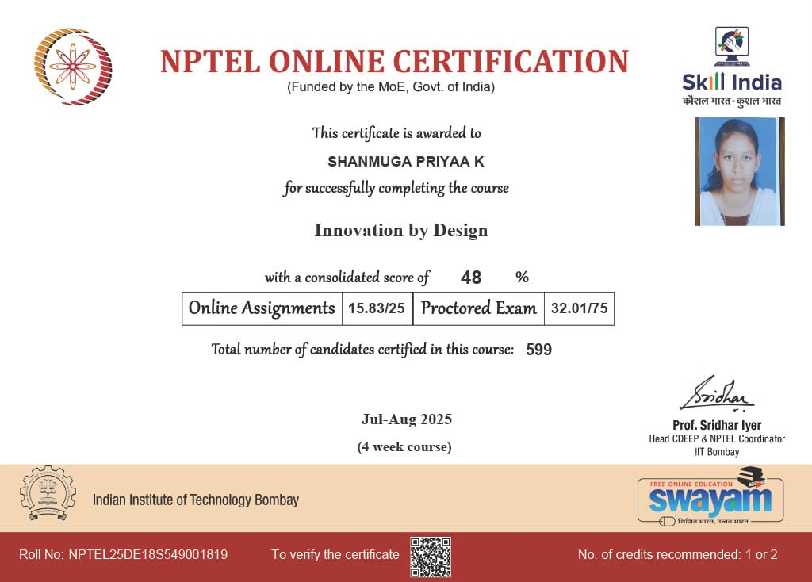
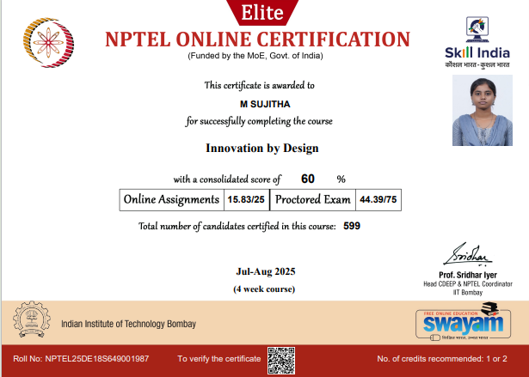
NPTEL CERTIFICATIONS

Slide 18
THANK YOU!

